Slide 1

WEB SCRAPPING Hussain Raza Rizvi SP23-MSCS-0012 Usman Bin Hamid SP23-MSCS-0014
Web Page : www.priceoye.pk

Slide 2
Table of contents
01: Introduction To the Problem? 02: Explain the Tasks You Preformed 03: Future Enhancements

Slide 3

01
Introduction To the Problem.

Slide 4
Introduction To the Problem.
Problem:
Difficulty in obtaining data from webpages for analysis and visualization.
Lack of real-time and accurate information on rate lists for products or services.
Inability to track competitor prices and offerings efficiently.

Slide 5
Introduction To the Problem.
Solution:
Developed a data retrieval system that extracts information from webpages.
Implemented data visualization techniques to present the extracted data in a user-friendly format.
Created a streamlined process for updating and maintaining the retrieved data.

Slide 6
Introduction To the Problem.
Benefits:
Improved customer experience by providing up-to-date and accurate rate lists.
Enhanced competitive advantage by enabling real-time tracking of rival companies.
Increased efficiency in decision-making through easy-to-understand visualizations.

Slide 7
02
Explain the Tasks Preformed Web scrapping Data Cleaning Data Visualization

Slide 8
Explain the Tasks Preformed
Request
Sent a request to the website using the "requests" library to retrieve the HTML page.
Parsing
Utilized BeautifulSoup ("bs4") to parse and beautify the HTML code, enabling easy navigation and extraction of data.

Slide 9

Data Extraction
Implemented a loop structure (while loop with a nested for loop) to extract each item's price, market price, name, discount, and image from the HTML pages.
Data Storage - Stored the extracted data in list for further processing and analysis.

Slide 10

Explain the Tasks Preformed
Data Cleaning
We performed minimal cleaning tasks, including adding column names, removing inconsistencies, and formatting currency. Additionally, we converted certain object columns to float type for further data processing and analysis. These actions enhance data accuracy

Slide 11

Explain the Tasks Preformed
Data Visualization
By visualizing the data, we were able to identify the companies' offering phones, laptops, and smartwatches in different price ranges. We also examined the discounts provided by these companies. Taking example visualizations highlighted that Apple has the highest-priced products compared to other brands. Through data visualization, we gained valuable insights and effectively communicated our findings.

Slide 12
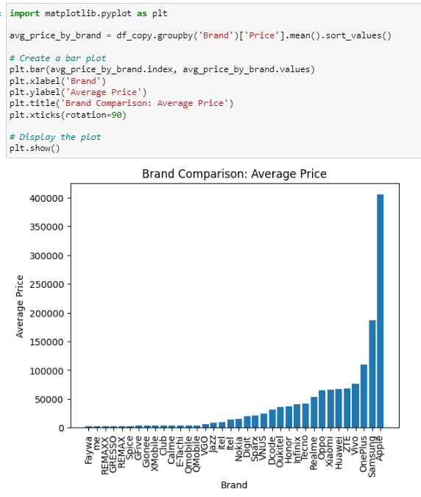

Slide 13
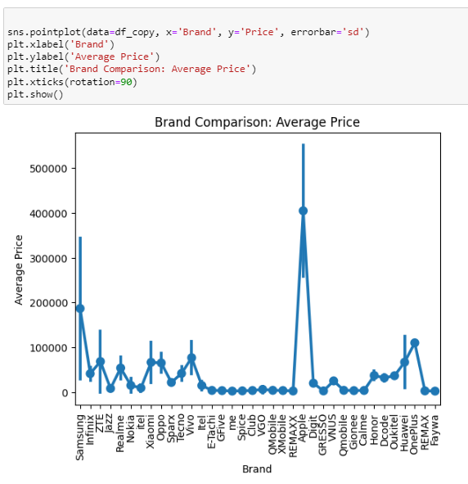
Main uses

Slide 14
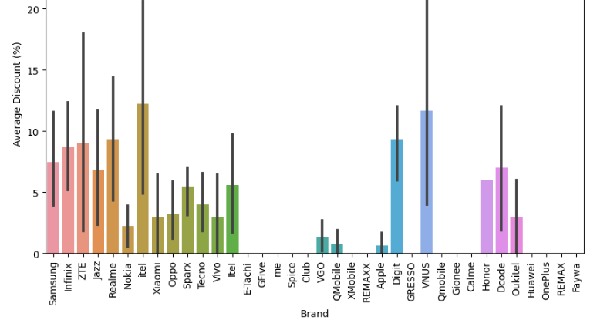

Slide 15
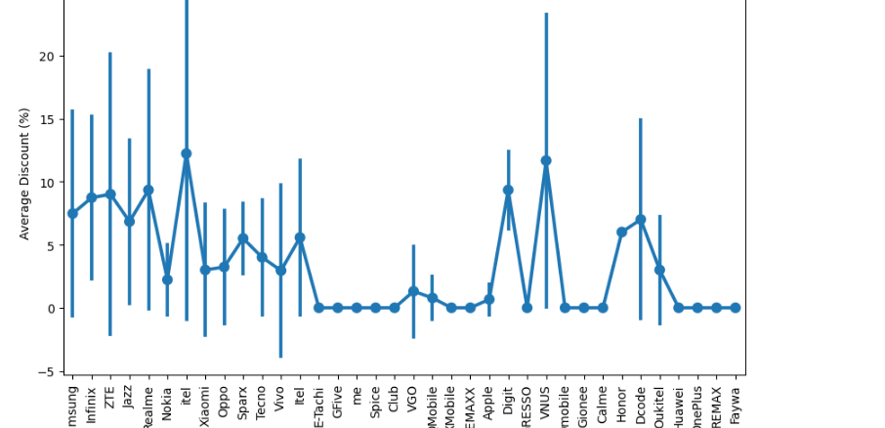
Average discount offered by Each Brand

Slide 16
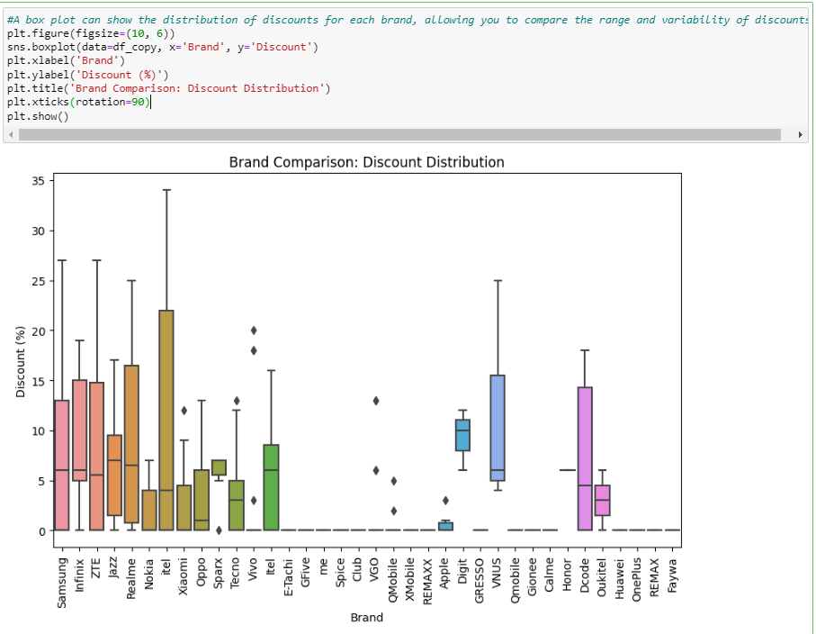
(AI)

Slide 17
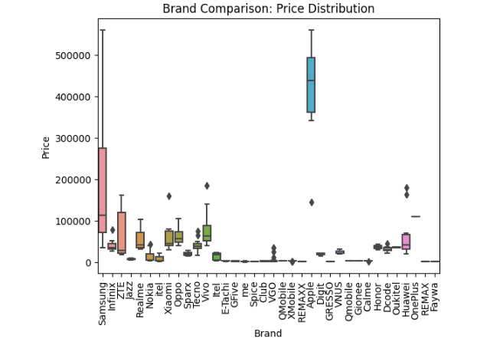

Slide 18
03
Future Enhancement

Slide 19
Future Enhancements
We can store the data in a permanent storage, such as a database, which enables us to compare prices on a monthly and weekly basis. Furthermore, users can view the prices of previous items, even if they are currently out of stock.
Moreover, we can gather comprehensive details, ratings, and specifications of all mobile devices. Using this information, we can predict the price of a new mobile device based on its specific specifications.

Slide 20

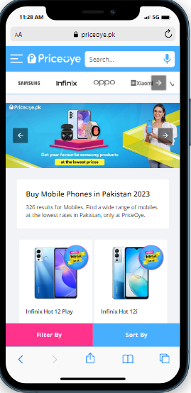
To provide a sophisticated user experience, we will create a refined user interface that allows users to easily access and explore the data.

Slide 21
Thanks ! Any questions?

